Slide 1
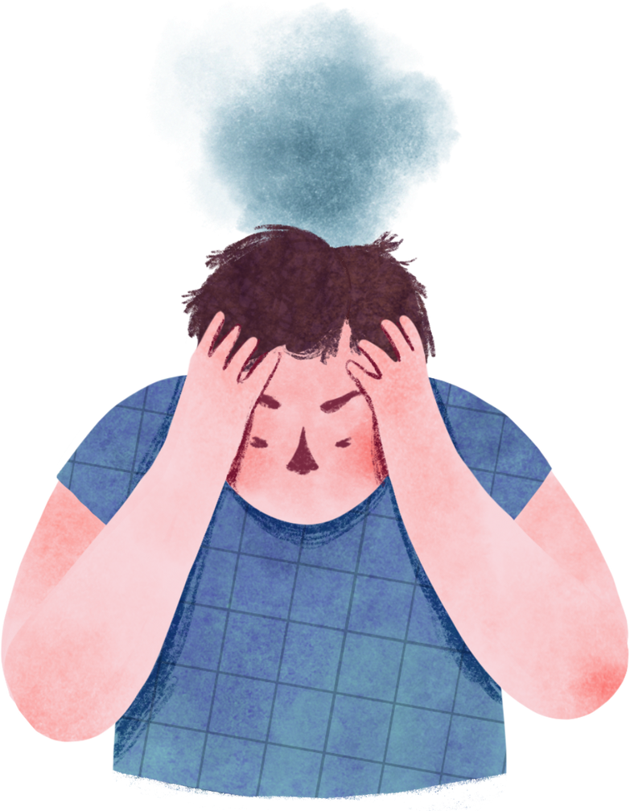
Mental health Prediction

Slide 2



EXPLORE OUR JOURNEY
The Big Idea
What inspired this project? Discover the spark that started it all.
Innovative Technology
Dive into the technical brilliance behind the solution.
Lifecycle Management
A look at how the system evolves and adapts seamlessly.
User Interaction
Experience the intuitive design tailored for every user.
Results & Impact
From insights to real-world outcomes, see how it all connects.

Slide 3


🌍 The Problem: Mental Health Crisis
Mental health disorders—such as depression, anxiety, and stress impact millions globally, often going undetected or untreated.
💡 Why It Matters
01 - THE BIG IDEA
Despite growing awareness, barriers like stigma and lack of early detection prevent people from seeking timely help. Proactively addressing mental health can transform lives and boost societal well-being.
🛠 Our Solution: Data Meets Empathy
Combines psychological survey data (DASS scores) with advanced machine learning algorithms to predict depression, anxiety, and stress levels. Provides real-time, actionable insights to users through an intuitive interface.
✨ Innovation: What Sets Us Apart
Our system:
Combines advanced machine learning with user-friendly design.
Ensures response validation through a word check that includes non-English terms.
Integrates a terms and conditions consent box to ensure ethical and transparent data usage.

Slide 4

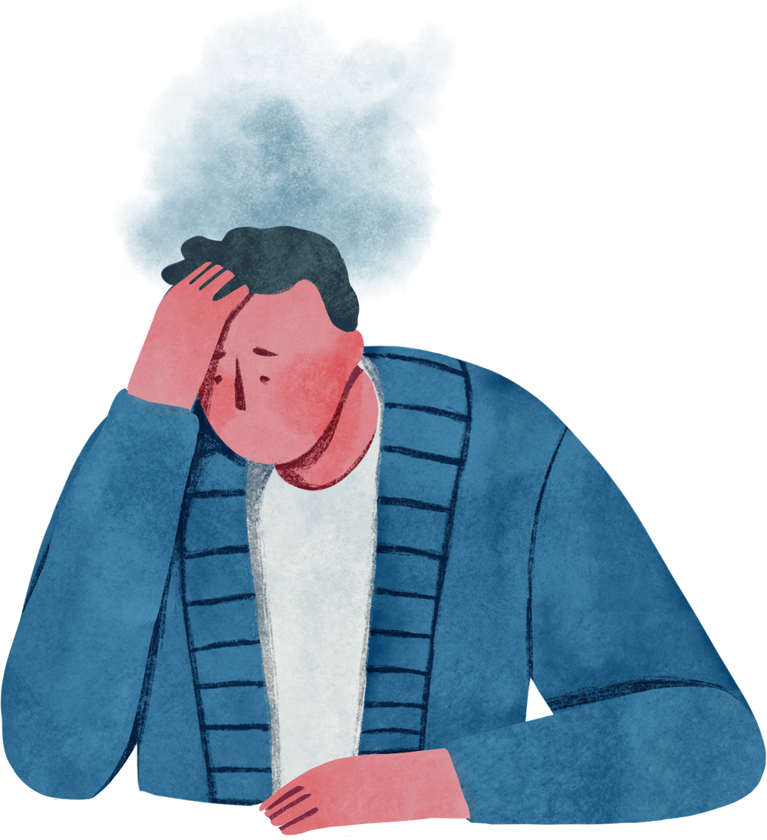
2 - TECHNICAL COOLNESS: KEY FEATURES
Smart Vocabulary Validation
Verifies user input with a real-time dictionary check, ensuring response quality and accuracy.
Real-Time Predictions
Provides instant feedback on Depression, Stress, and Anxiety levels, leveraging machine learning.
Ethical Data Usage
Implements secure data handling with user consent via terms and conditions.
Dynamic Data Processing
Adapts preprocessing steps based on survey structure for seamless usability.
Optimized Model Deployment
Employs high-performance machine learning models to maximize prediction accuracy.

Slide 5

LIFE CYCLE MANAGEMENT
Idea to Conceptualization
Data Preprocessing and Model Development
Deployment
Real-World Testing and Monitoring
Key Decisions and Overcoming Challenges

Slide 6
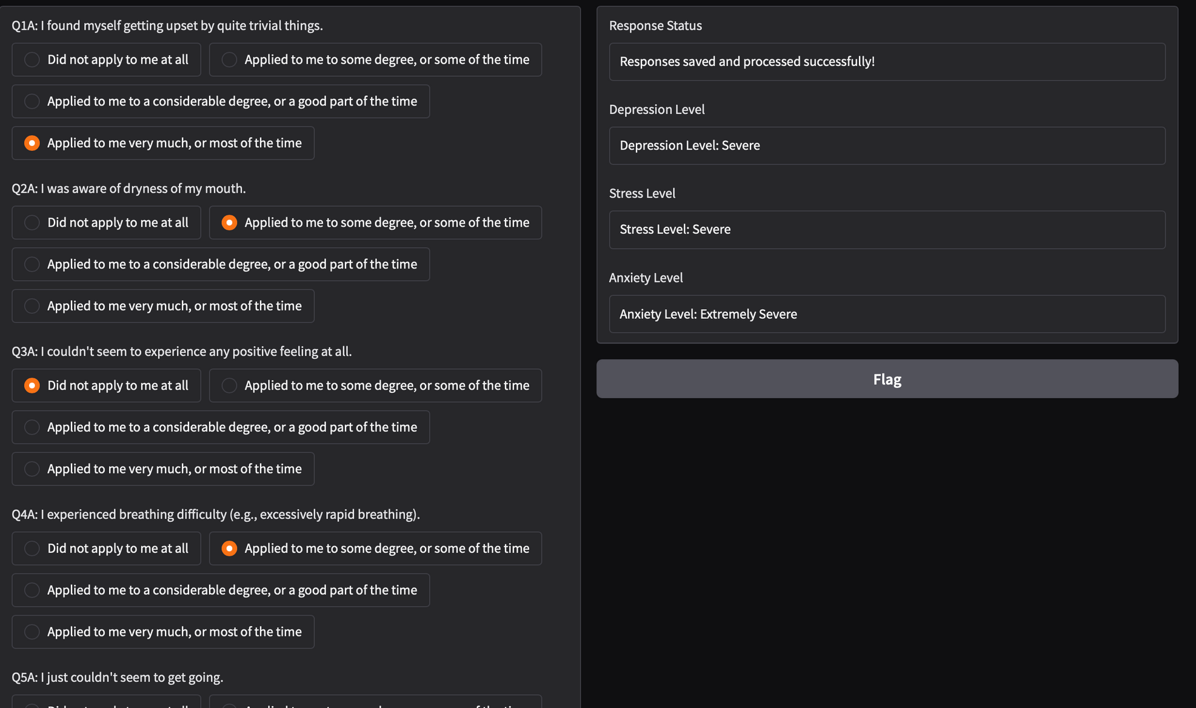
USER INTERACTION

Slide 7

RESULTS AND IMPACT
🎯 Precision in Predictions
Achieving high accuracy through advanced machine learning models tailored to mental health.
🛡️ Input Validation
Ensuring reliability by validating survey responses and preventing errors with smart checks.
⏱️ Real-Time Analysis
Providing instant results to help users better understand their mental health.
😊 User-Centric Design
Focusing on user satisfaction with an intuitive interface and seamless experience.
🌍 Bridging Awareness and Action
Empowering individuals to act on insights and seek timely support.
🔑 Accessible and Inclusive
Designed to be accessible for all users, with clear visuals and easy-to-use features.
🔒 Ethical and Secure
Prioritizing data security and respecting user privacy at every step.
💡 Promoting Mental Health Awareness
Raising awareness through innovative tools, fostering a healthier society.

Slide 8
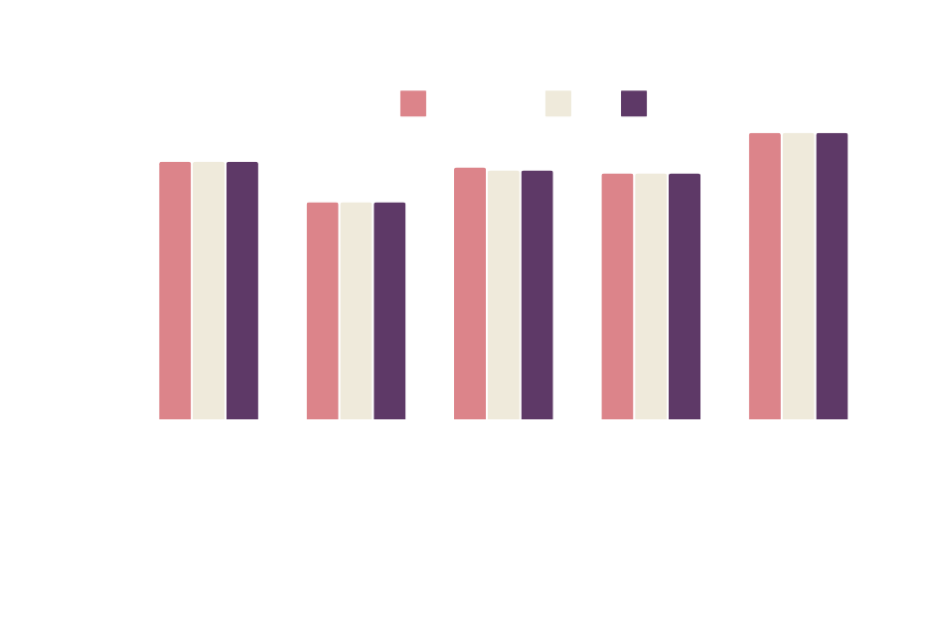
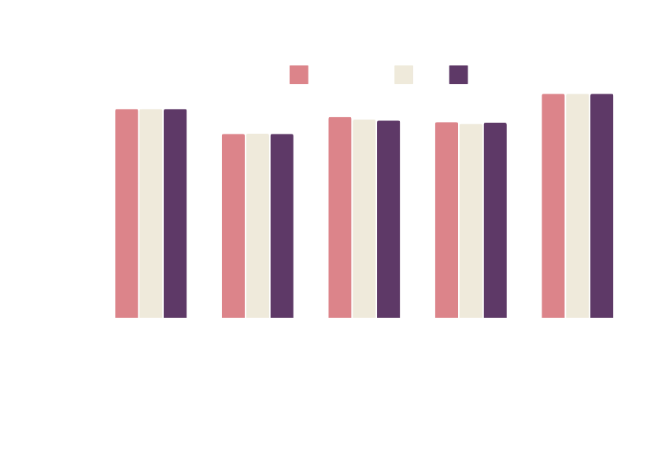
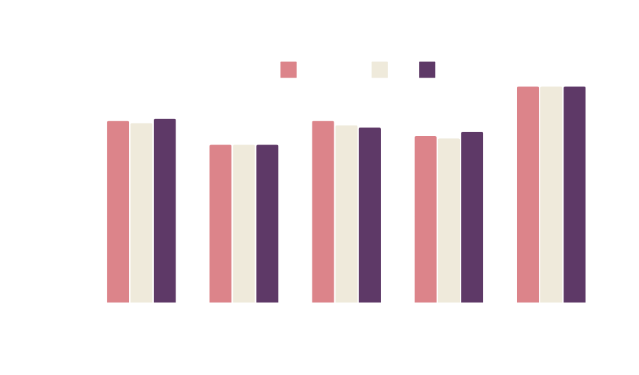
RESULTS
Stress
Depression
Anxiety

Slide 9

Thank You

